Slide 1

Professional Practices (HUM-305)
SPRING SEMESTER 2026
By
Prof Engr Muhammad Raheel Iqbal Butt
Resource Person
Contact: +92 321 7433568
School of Computer & Information Technology
Beaconhouse National University, Lahore

Slide 2
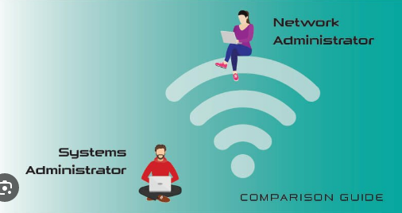

Slide 3
Chap 12: System Admin Audit, Network
Security (SANS)
IT Code of Ethics
Human Resource Management and IT

Slide 4
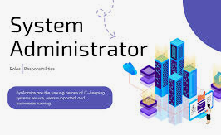

Slide 5
1. Security (SANS)
1. Security (SANS)
Introduction
SANS Institute is a leading global organization in cybersecurity training and research.
Focuses on information security awareness, best practices, and incident response.
Key Areas of SANS Security
Cyber security Training
Provides certifications like GIAC.
Threat Intelligence
Identifies and analyzes cyber threats.
Incident Response
Helps organizations respond to cyber attacks quickly.

Slide 6
1. Security (SANS)
SANS Security Principles
Defense in Depth
Multiple layers of security (firewalls, encryption, monitoring).
Least Privilege
Users get only the access they need.
Continuous Monitoring
Systems should be monitored 24/7.
Risk Management
Identify and reduce vulnerabilities.
Common Security Controls (SANS Top Practices)
Access control
Data protection
Network security
Security awareness training

Slide 7
1. Security (SANS)
Importance
Protects organizations from cyber threats.
Ensures data confidentiality, integrity, and availability (CIA triad).
Reduces financial and reputational loss

Slide 8
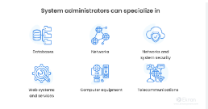

Slide 9
2. IT Code of Ethics
Introduction
IT Code of Ethics defines moral principles and standards for IT professionals.
Ensures responsible use of technology and data.
Core Principles
Confidentiality
Protect user and organizational data.
Integrity
Ensure accuracy and reliability of systems.
Availability
Systems should be accessible when needed.

Slide 10
2. IT Code of Ethics
Professional Responsibilities
Avoid unauthorized access to systems.
Do not misuse data or software.
Follow laws and organizational policies.
Report security breaches responsibly.
Ethical Issues in IT
Data privacy violations
Cybercrime (hacking, phishing)
Software piracy
AI misuse and bias

Slide 11
2. IT Code of Ethics
Best Practices
Follow organizational IT policies.
Use strong passwords and encryption.
Maintain transparency in system design.
Importance
Builds trust between users and organizations.
Prevents misuse of technology.
Promotes responsible innovation.

Slide 12
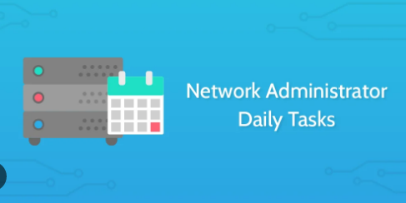

Slide 13
3. Human Resource Management and IT
Introduction
Human Resource Management (HRM) and IT work together to improve organizational efficiency and employee management.
IT plays a key role in modern HR systems.
Role of IT in HRM
Automation
Payroll, attendance, recruitment systems.
HR Information Systems (HRIS)
Centralized employee data management.
E-Recruitment
Online job portals and applicant tracking.
Performance Management
Digital evaluation and feedback systems.

Slide 14
3. Human Resource Management and IT
Benefits of IT in HRM
Saves time and cost.
Improves data accuracy.
Enhances decision-making.
Enables remote work and digital collaboration.
Challenges
Data privacy concerns
System security risks
Employee resistance to technology
High implementation cost

Slide 15
3. Human Resource Management and IT
Ethical Considerations
Protect employee data confidentiality.
Avoid bias in automated recruitment systems.
Ensure transparency in monitoring tools.
Future Trends
AI in recruitment and HR analytics
Cloud-based HR systems
Remote workforce management tools

Slide 16


Slide 17
4. Combined Importance
4. Combined Importance
Security (SANS) ensures protection of systems and data.
IT Code of Ethics ensures responsible use of technology.
HRM + IT improves workforce efficiency and management.
Together, they:
Enhance organizational security
Promote ethical behavior
Improve productivity and decision-making

Slide 18
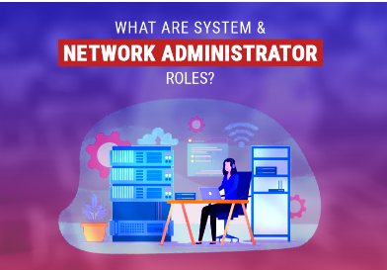

Slide 19
Conclusion Slide
Conclusion Slide
Organizations must balance technology, ethics, and people management.
Following standards from SANS Institute and ethical practices ensures:
Secure systems
Trustworthy professionals
Efficient organizations

Slide 20


Slide 21


